Slide 1
Application of SVD Low Rank Decomposition in Model Compression
Xiusheng, Huang
Nov. 08, 2024

Slide 2
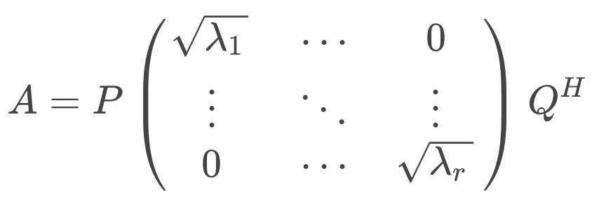

What is SVD?
For any matrix M ∈ R ^ n x m, the following form of singular value decomposition can be found（SVD，Singular Value Decomposition），$A=A_{mxn}$, $r = rank(A)>0$,
P. Q are all orthogonal matrices, and the λ of $A^{T}A$ in the diagonal matrix are arranged in descending order
What is Cholesky decomposition?
It is a special method for factoring symmetric positive definite matrix A. It decomposes a symmetric positive definite matrix into the product of a lower triangular matrix and its transpose, i.e
Where L is a lower triangular matrix

Slide 3
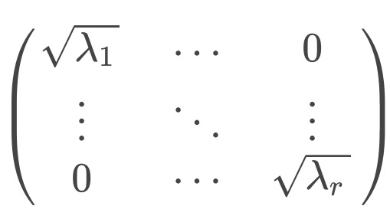

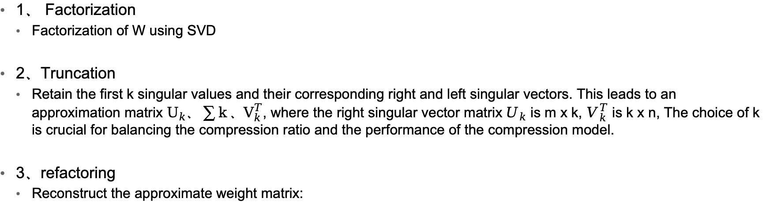
Previous SVD based compression methods
1、 Factorization
  Factorization of W using SVD
2、Truncation
  Retain the first k singular values and their corresponding right and left singular vectors. This leads to an approximation matrix $U_{k}、\sum{k}、V_{k}^{T}$, where the right singular vector matrix $U_{k}$ is m x k, $V_{k}^{T}$ is k x n, The choice of k is crucial for balancing the compression ratio and the performance of the compression model.
3、refactoring
  Reconstruct the approximate weight matrix:

Slide 4
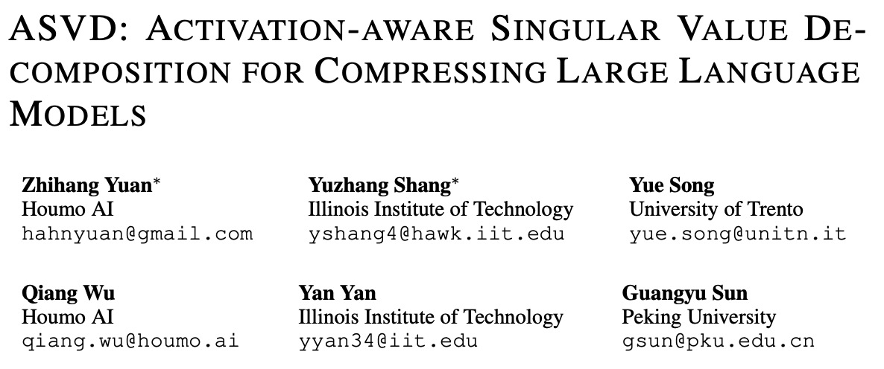
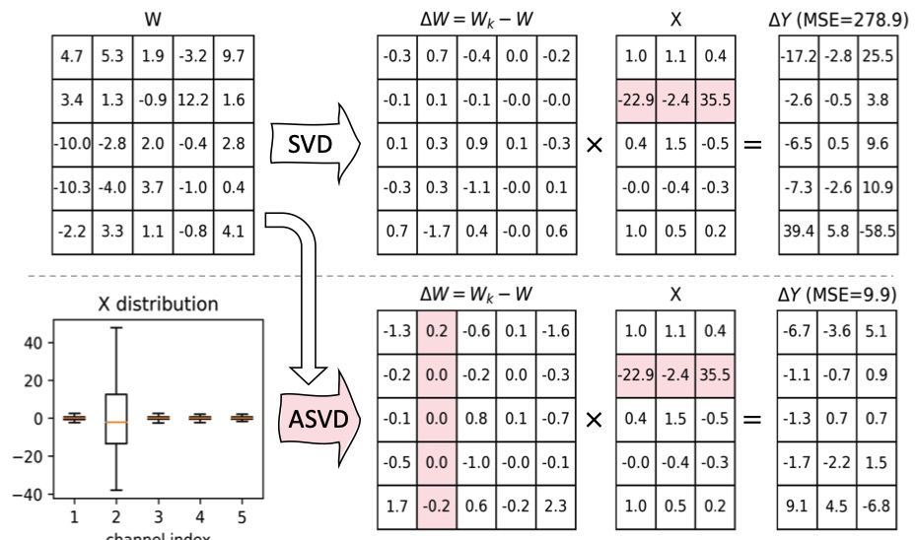
Paper sharing
  Motivation

Slide 5

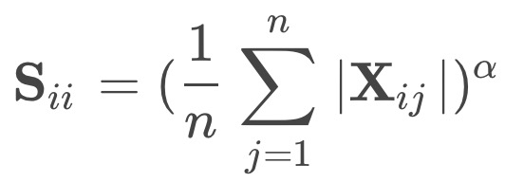
  1、Scaling of weight matrix
    The first step involves scaling the weight matrix W through the diagonal matrix S. This matrix S is constructed to represent the influence of input channels on weights, essentially adjusting W to better adapt to the activation mode of input X. The scaled weight matrix is represented as W S, and the equation is represented as
    This scaling step modifies the weight matrix to reflect the different importance of different input channels, making the decomposition more effective and targeted.
  2、Setting of matrix S
    S itself reduces Δ Y ， so S is related to the activation of X and can be expressed by a formula
    In the equation, n s the total number of activations for the i-th channel, and the hyperparameter alpha alpha provides flexibility to adjust the level of activation sensitivity incorporated into scaling

Slide 6


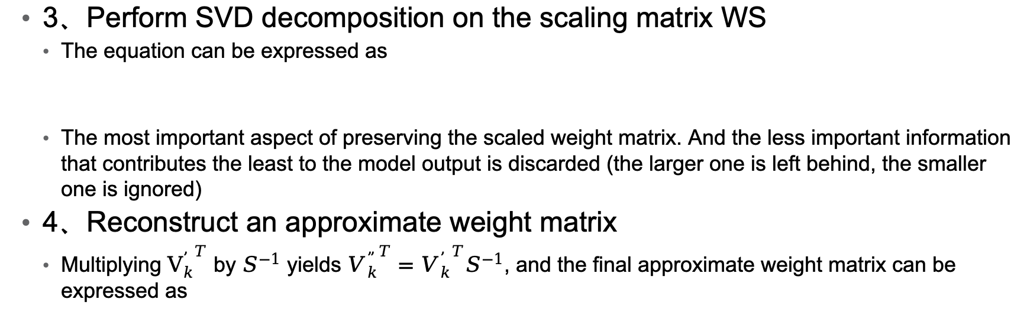
  3、Perform SVD decomposition on the scaling matrix WS
    The equation can be expressed as
    The most important aspect of preserving the scaled weight matrix. And the less important information that contributes the least to the model output is discarded (the larger one is left behind, the smaller one is ignored)
  4、Reconstruct an approximate weight matrix
    Multiplying ${V_{k}^{’}}^{T}$ by $S^{−1}$ yields ${V_{k}^{”}}^{T}={V_{k}^{’}}^{T}S^{−1}$, and the final approximate weight matrix can be expressed as

Slide 7
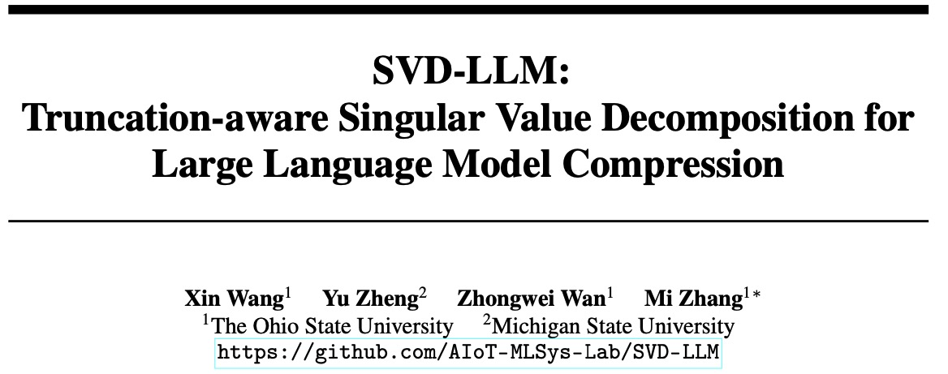
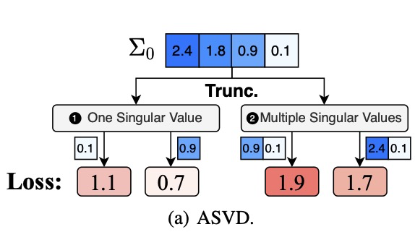
Paper sharing
  Motivation

Slide 8
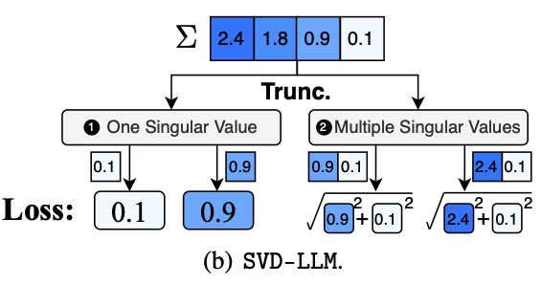



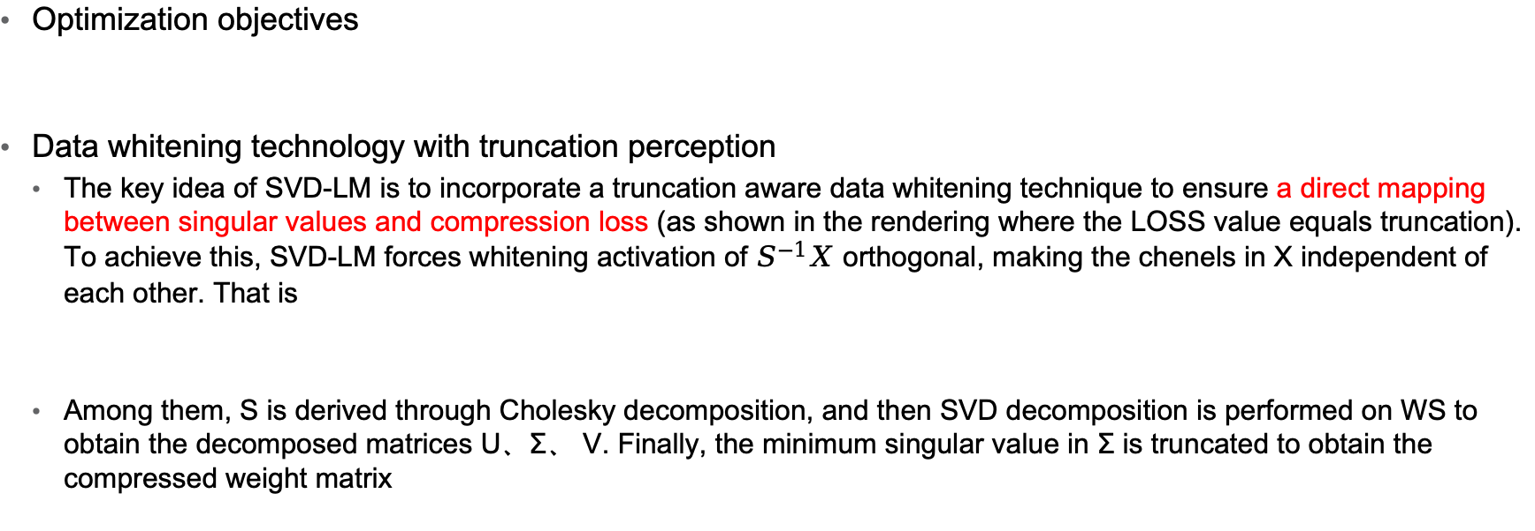
SVD-LLM
Optimization objectives
Data whitening technology with truncation perception
  The key idea of SVD-LM is to incorporate a truncation aware data whitening technique to ensure a direct mapping between singular values and compression loss (as shown in the rendering where the LOSS value equals truncation). To achieve this, SVD-LM forces whitening activation of $S^{−1}X$ orthogonal, making the chenels in X independent of each other. That is
  Among them, S is derived through Cholesky decomposition, and then SVD decomposition is performed on WS to obtain the decomposed matrices U、Σ、 V. Finally, the minimum singular value in Σ is truncated to obtain the compressed weight matrix

Slide 9
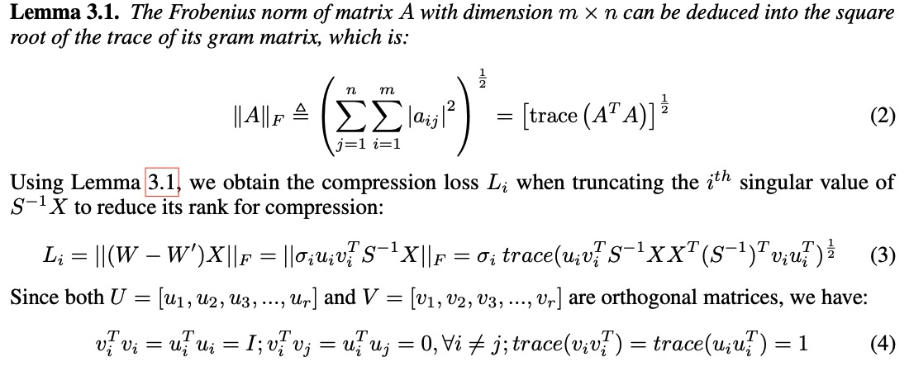
SVD-LLM
Theoretical proof

Slide 10
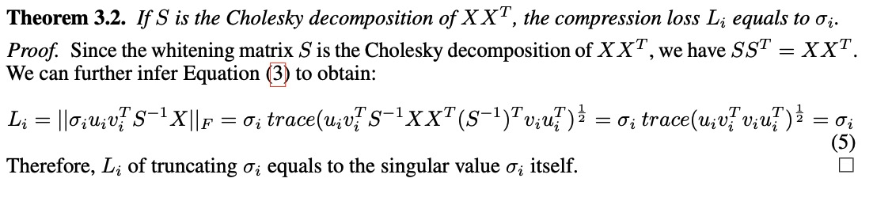
SVD-LLM
Theoretical proof

Slide 11
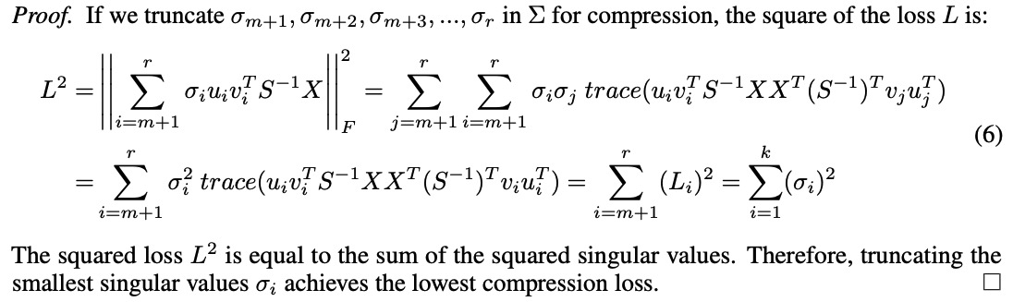
SVD-LLM
Theoretical proof

Slide 12
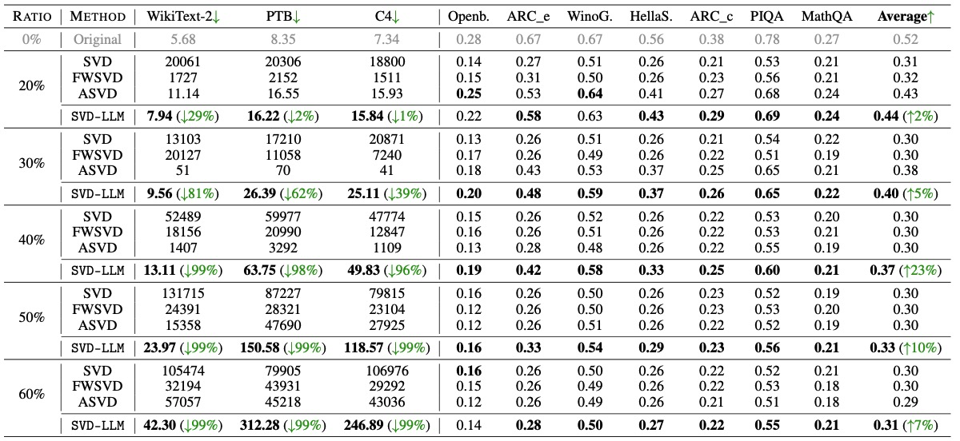
SVD-LLM
experimental result

Slide 13
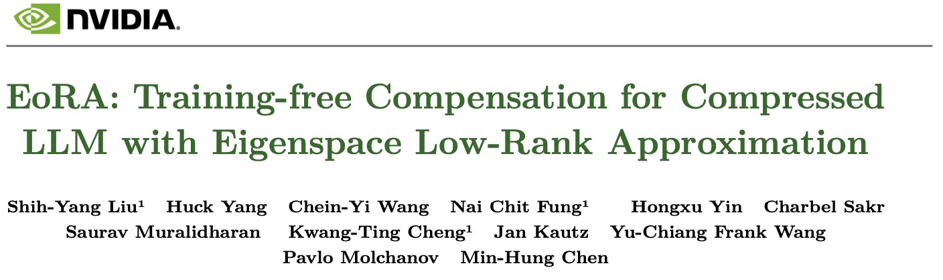
Paper sharing
Motivation
  EoRA (Training free Eigenspace Low Rank Approximation) is a compensation method that does not require gradient training. It repairs errors in compressed models by performing low rank approximations in the feature space. This means that you don't need to spend a lot of time fine-tuning, but can quickly compensate for compression errors with a small amount of calibration data in a few minutes.

Slide 14




EoRA
The compression error of each layer is
Application of SVD decomposition
Re formalize the definition:
Error approximation loss can be formulated as:

Slide 15








EoRA
Get the average value of X for all aligned data inputs
factorization
Setting:
Make
Approximately equal to
And
The weight in the final forward reasoning is

Slide 16
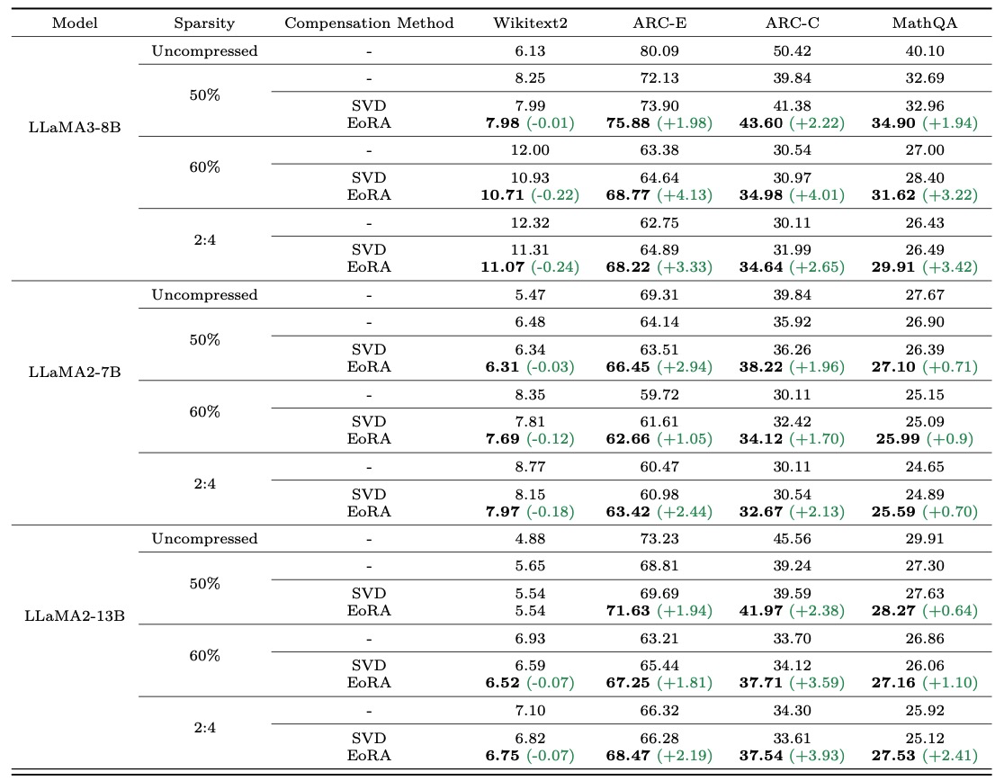
SVD-LLM
experimental result

